Slide 1
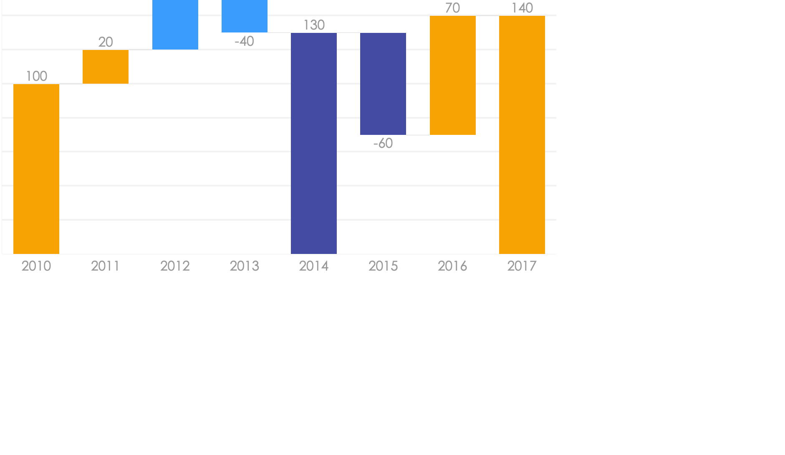
Waterfall Charts Infographics
Analysis of different brands and products.
Sell
Business professionals like you connecting.
Buy
Business professionals like you connecting.
Return
Business professionals like you connecting.

Slide 2
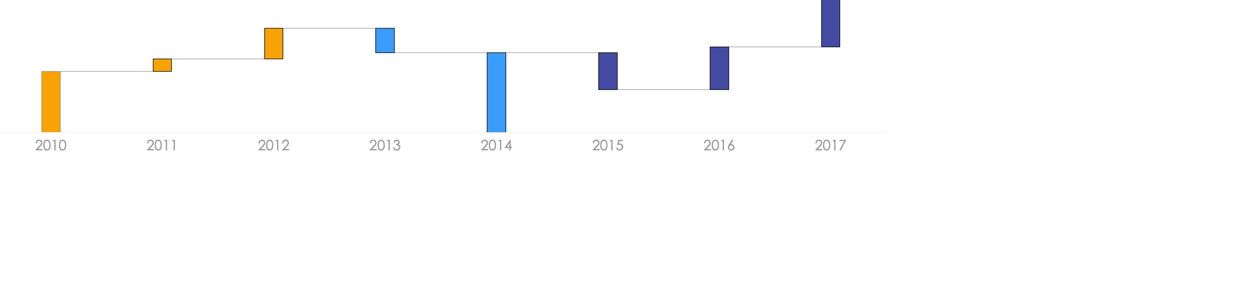
Waterfall Charts Infographics
Analysis of different brands and products.
40%
Business professionals like you connecting to share advice.
25%
Business professionals like you connecting to share advice.
45%
Business professionals like you connecting to share advice.
Sell
Buy
Return

Slide 3
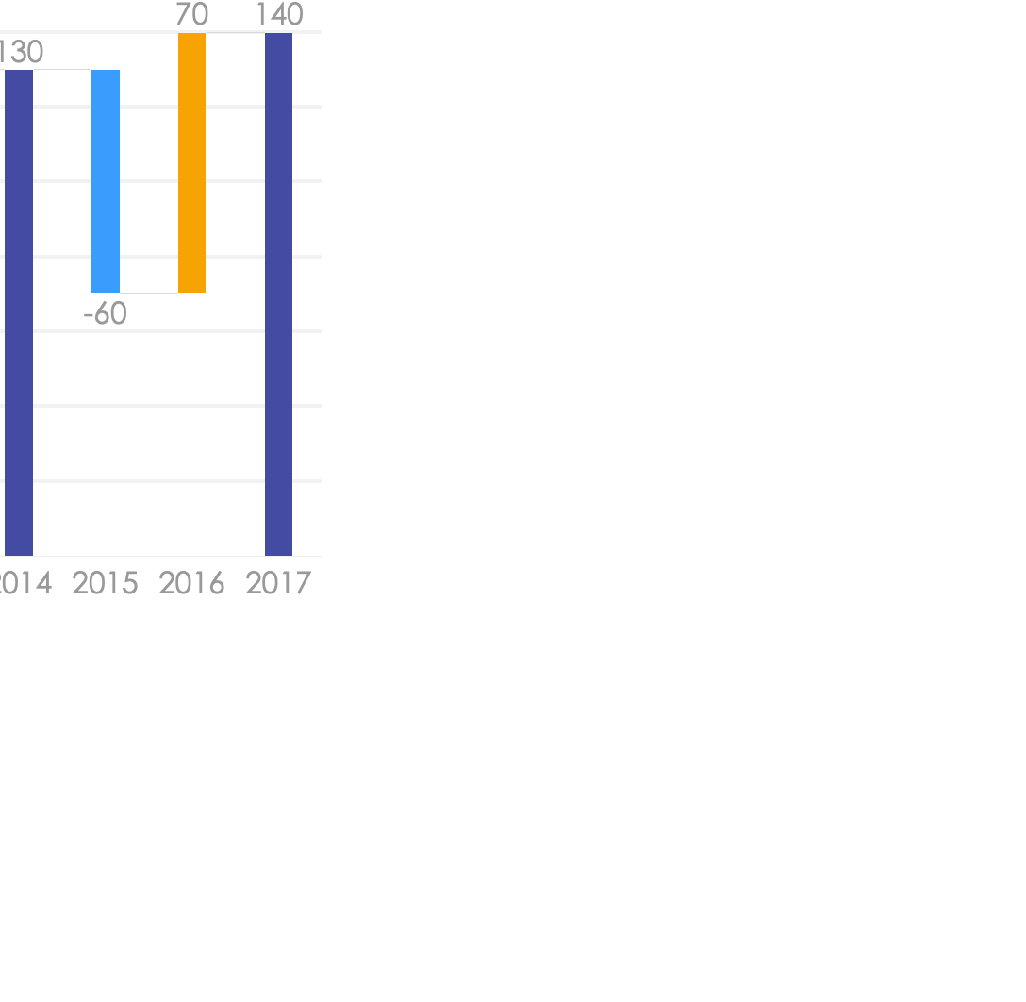
Waterfall Charts Infographics
Analysis of different brands and products.
01
Sell
Business professionals like you connecting to share advice.
02
Buy
Business professionals like you connecting to share advice.
03
Returns
Business professionals like you connecting to share advice.

Slide 4
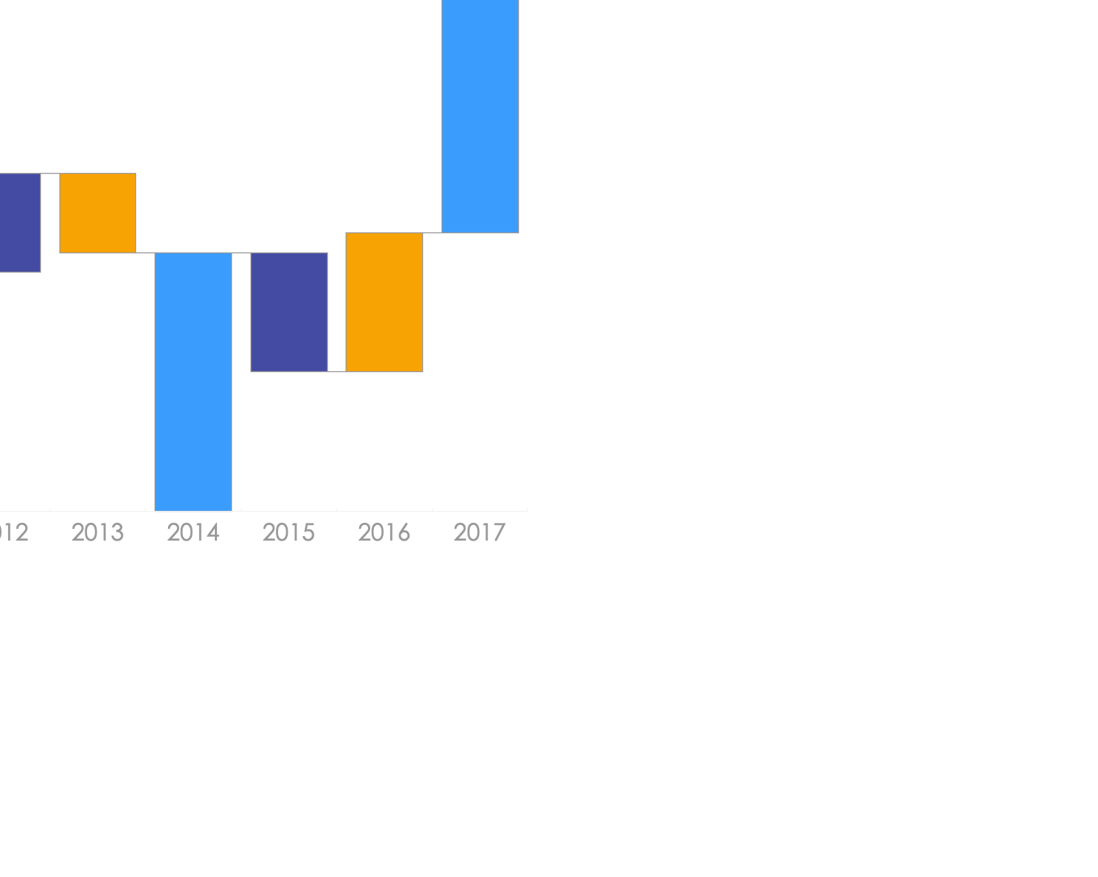
Waterfall Charts Infographics
Analysis of different brands and products.
01
Community
Business professionals like you connecting to share advice.
02
Competitors
Business professionals like you connecting to share advice.
03
Financial
Business professionals like you connecting to share advice.

Slide 5
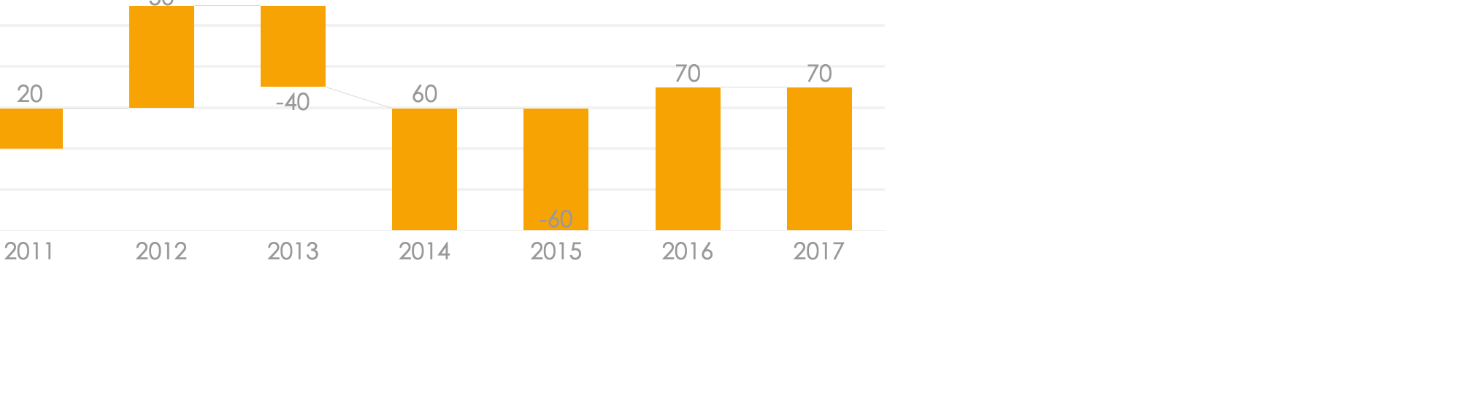
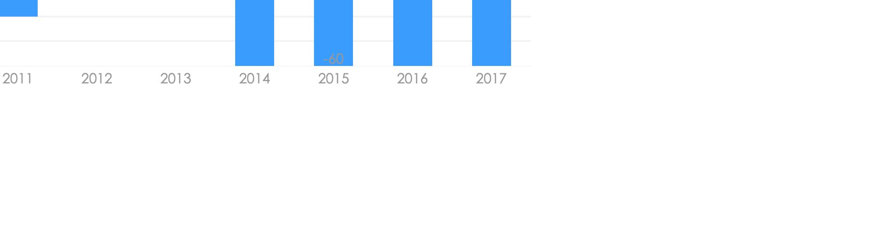
Waterfall
Charts
Infographics
Analysis of different brands and products.
Business
Business professionals like you connecting to share advice.
Community
Business professionals like you connecting to share advice.

Slide 6

Waterfall Charts Infographics
Analysis of different brands and products.
That’s why we provide point and
click solutions.
Business professionals like you connecting to share advice. Business professionals like you connecting to share advice. Business professionals like you connecting to share advice.

Slide 7
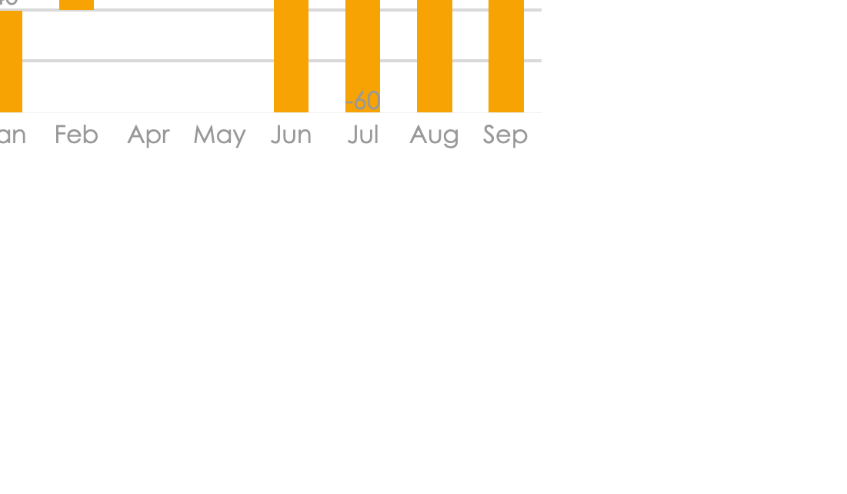
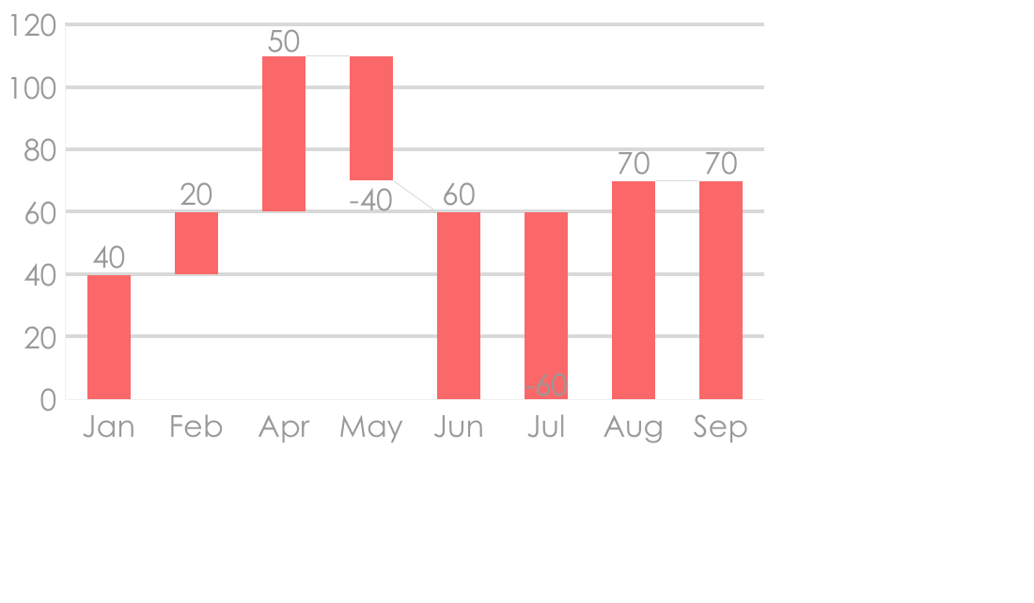
Waterfall Charts Infographics
Analysis of different brands and products.
Sells 2010
Sells 2011
Business professionals like you connecting to share advice.
Business professionals like you connecting to share advice.

Slide 8
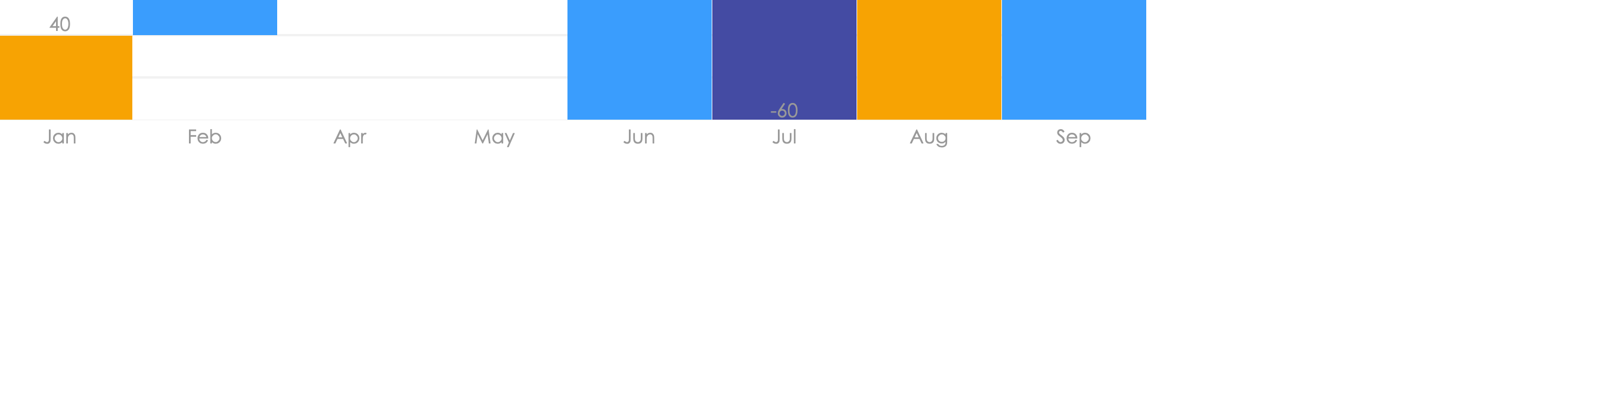
Waterfall Charts Infographics
Analysis of different brands and products.
Sell
Buy
Returns
Business professionals like you connecting to share advice.
Business professionals like you connecting to share advice.
Business professionals like you connecting to share advice.

Slide 9
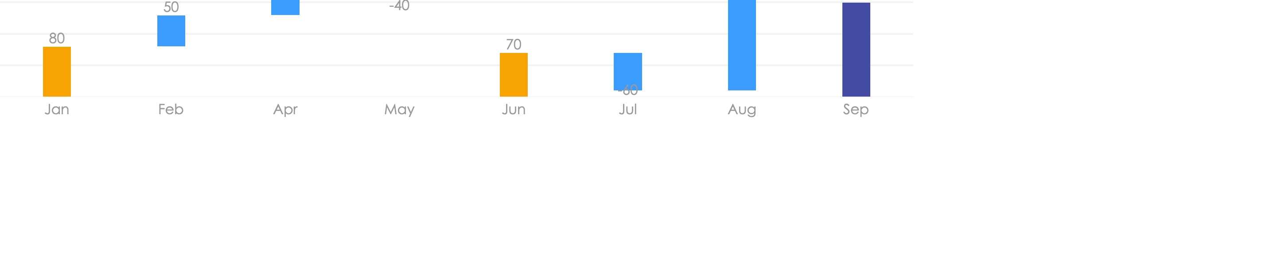
Waterfall Charts Infographics
Analysis of different brands and products.
In Stock | 12 | 23 | 20
Purchased | 15 | 34 | 67
Sold | 87 | 34 | 12

Slide 10
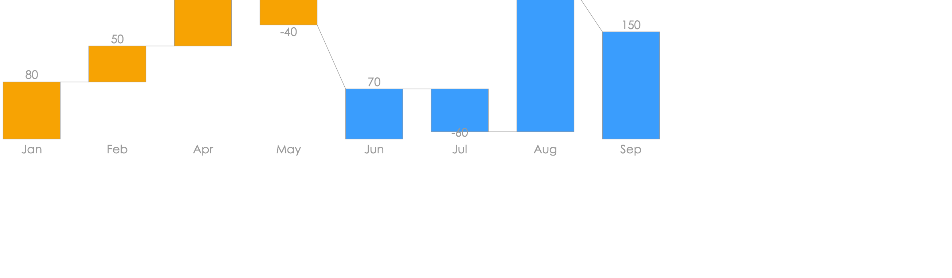
Waterfall Charts Infographics
Analysis of different brands and products.
In Stock
Purchased
50%
Business professionals like you connecting to share advice.
70%
Business professionals like you connecting to share advice.

Slide 11
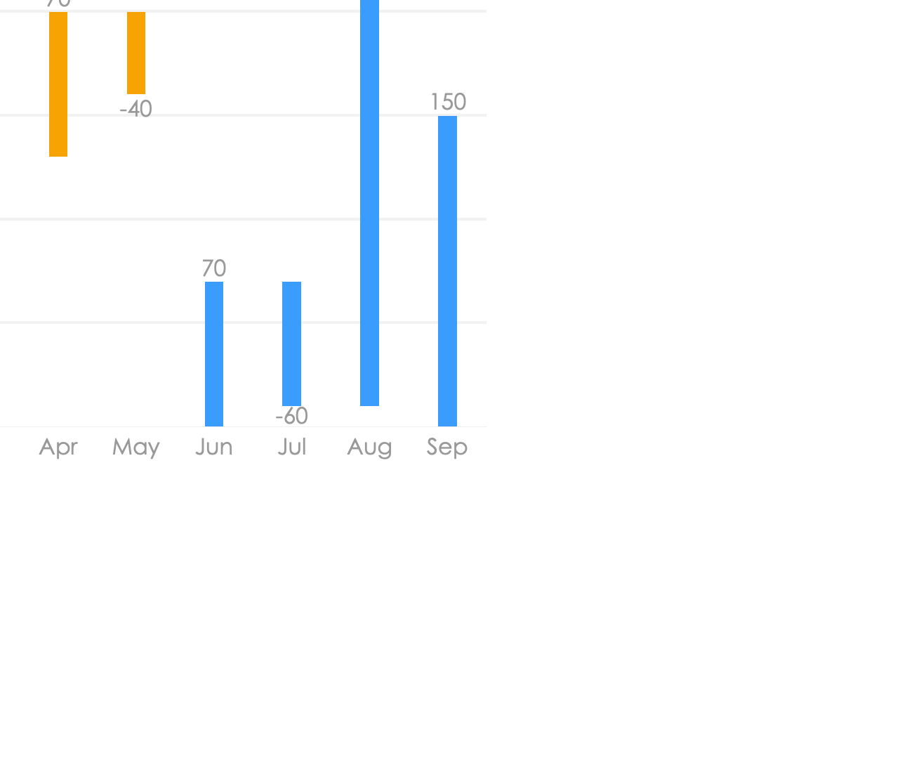
Waterfall Charts Infographics
Analysis of different brands and products.
01
02
That’s why we provide point solutions
That’s why we provide point solutions
Business professionals like you connecting to share advice.
Business professionals like you connecting to share advice.

Slide 12
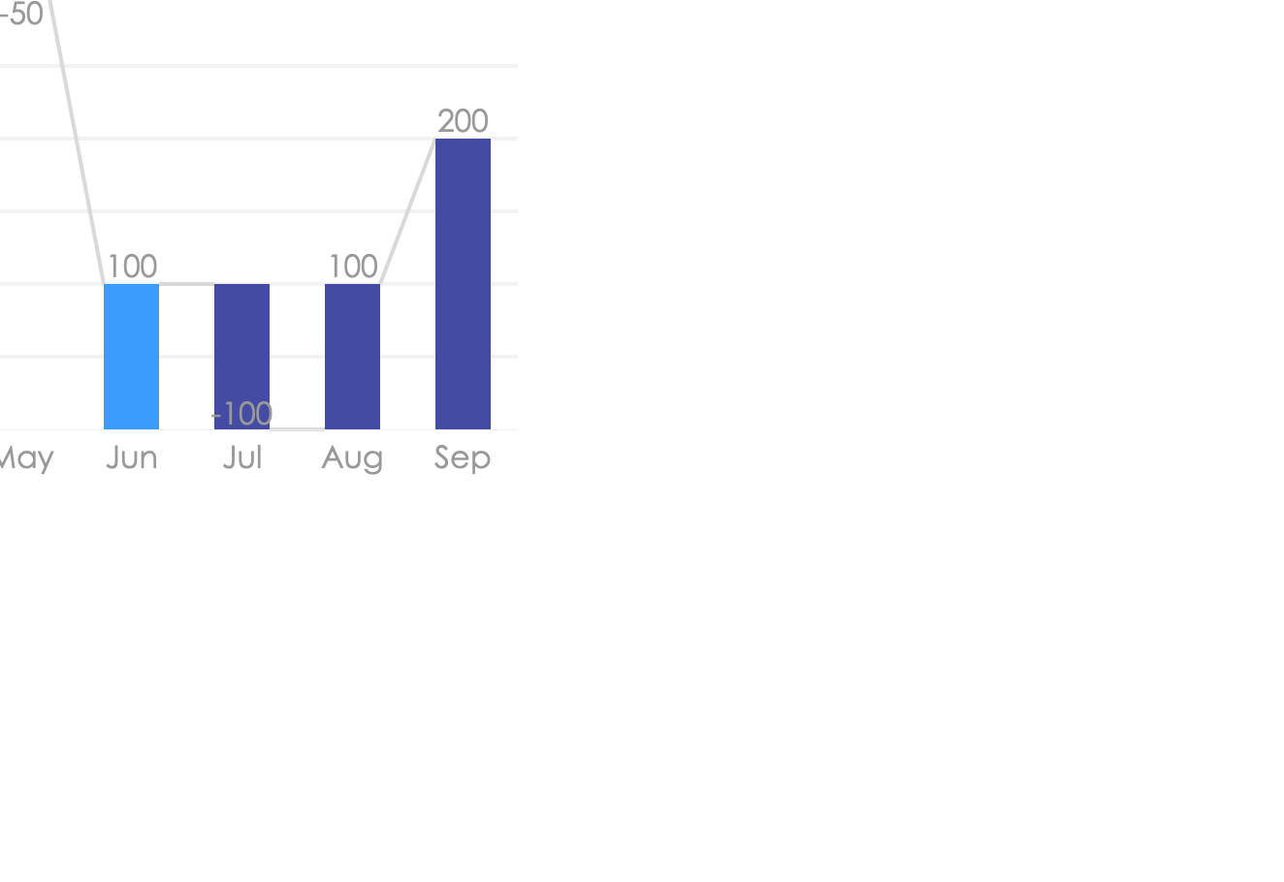
Waterfall Charts Infographics
Analysis of different brands and products.
35%
Business professionals like you connecting to share advice.
65%
Business professionals like you connecting to share advice.
45%
Business professionals like you connecting to share advice.

Slide 13
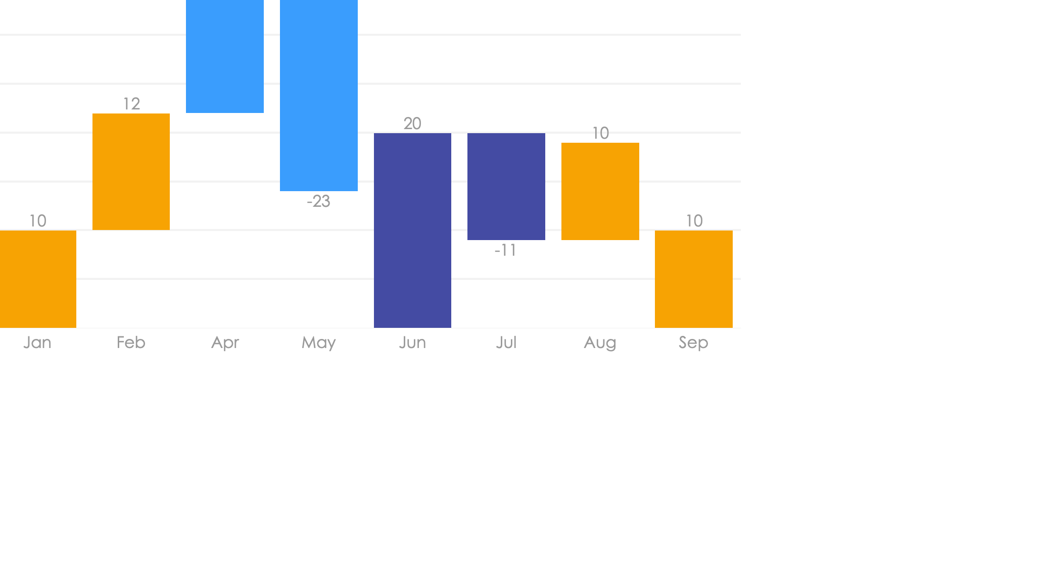
Waterfall Charts Infographics
Analysis of different brands and products.
Sells
Purchases
Expenses
Business professionals like you connecting to share advice.

Slide 14
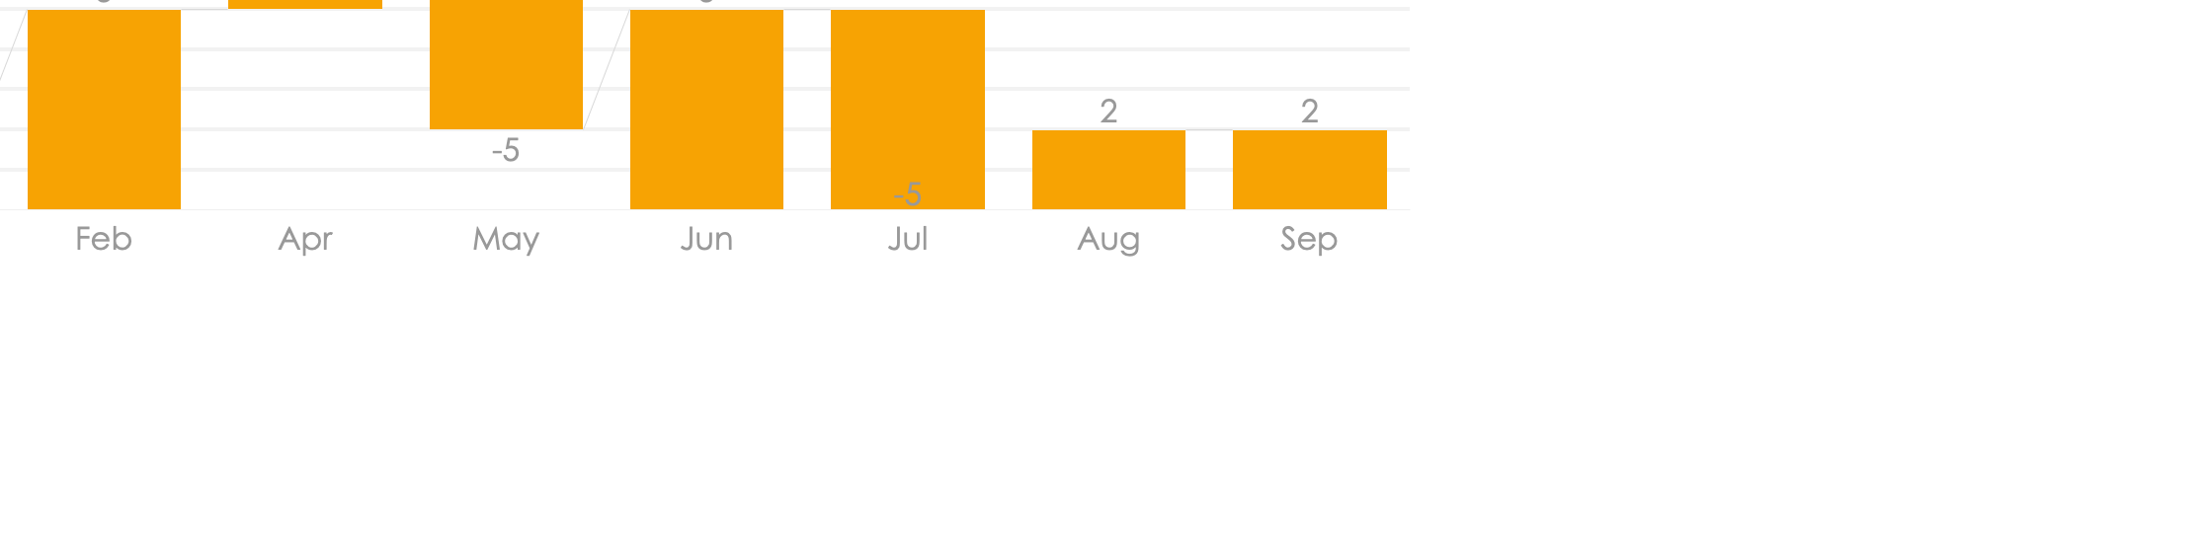

Waterfall Charts Infographics
Analysis of different brands and products.
65%
Business
Business professionals like you connecting to share advice.
10%
Community
Business professionals like you connecting to share advice.

Slide 15
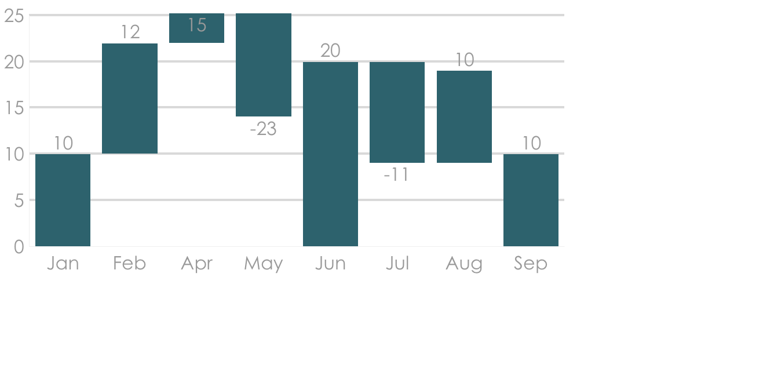
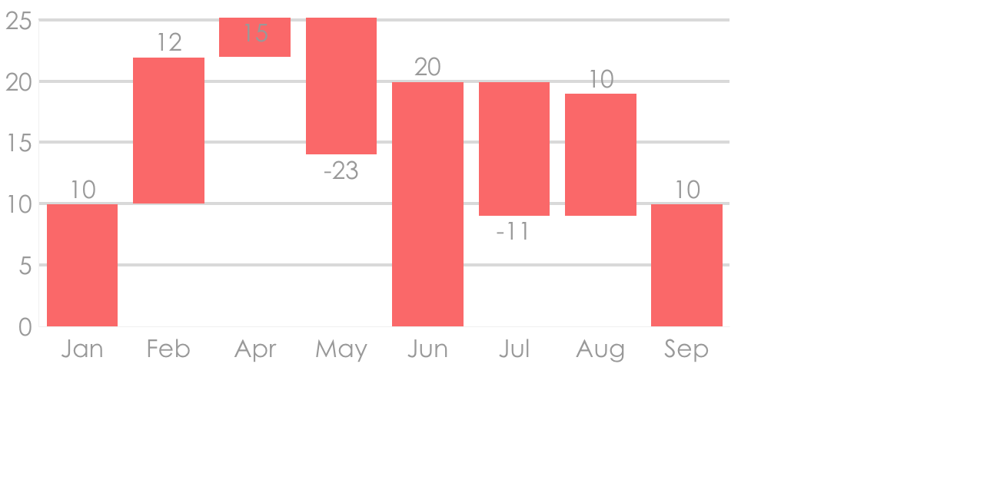
Waterfall Charts Infographics
Analysis of different brands and products.
Sells 2019
Purchases 2019
Business professionals like you connecting to share advice.
Business professionals like you connecting to share advice.

Slide 16
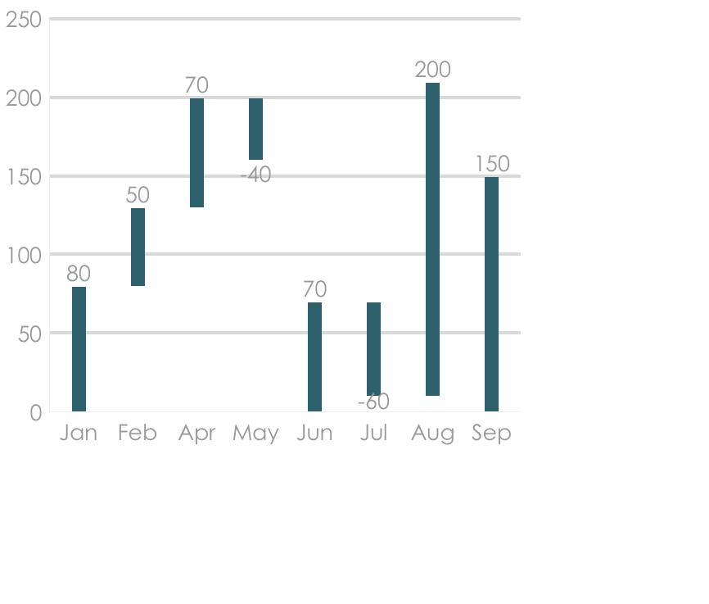
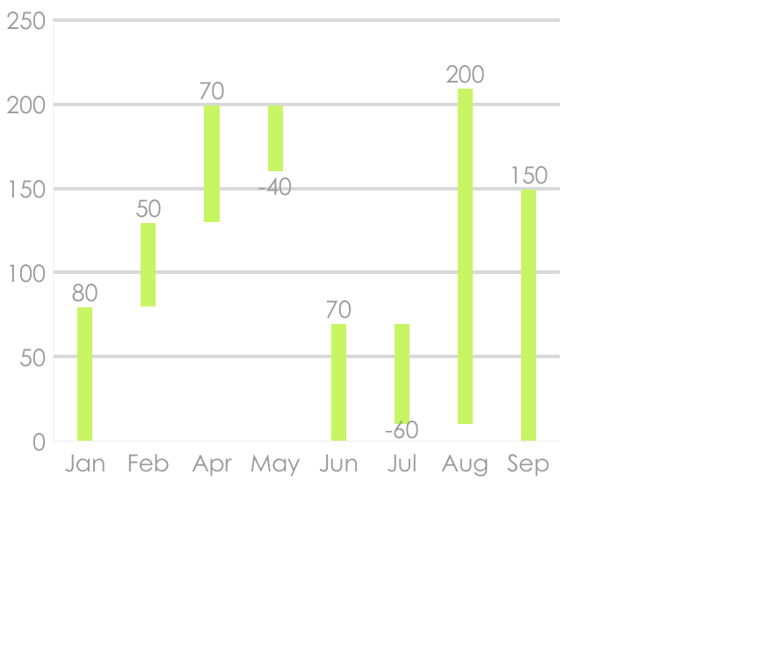
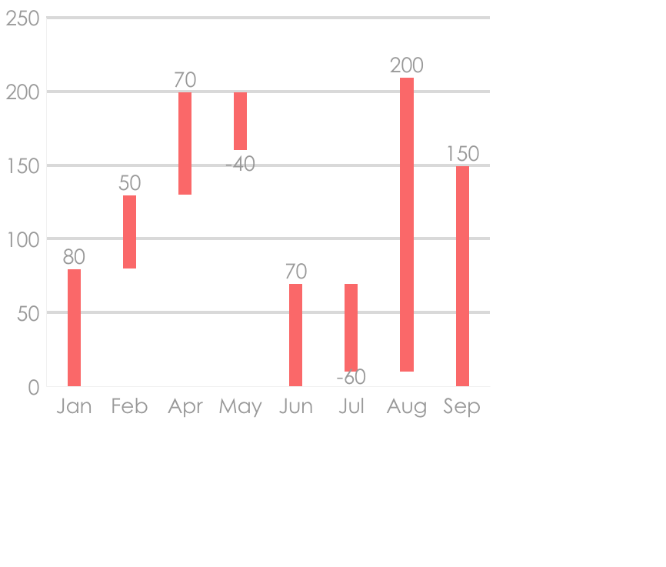
Waterfall Charts Infographics
Analysis of different brands and products.
Sells 2019
Purchases 2019
Returns 2019
Business professionals like you connecting to share advice.
Business professionals like you connecting to share advice.
Business professionals like you connecting to share advice.

Slide 17
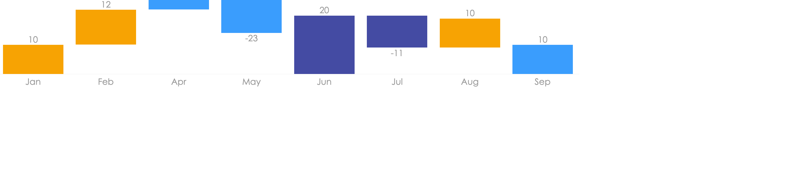
Waterfall Charts Infographics
Analysis of different brands and products.
Sells
Purchases
Returns
Business professionals like you connecting to share advice. Business professionals like you connecting to share advice. Business professionals like you connecting to share advice.

Slide 18
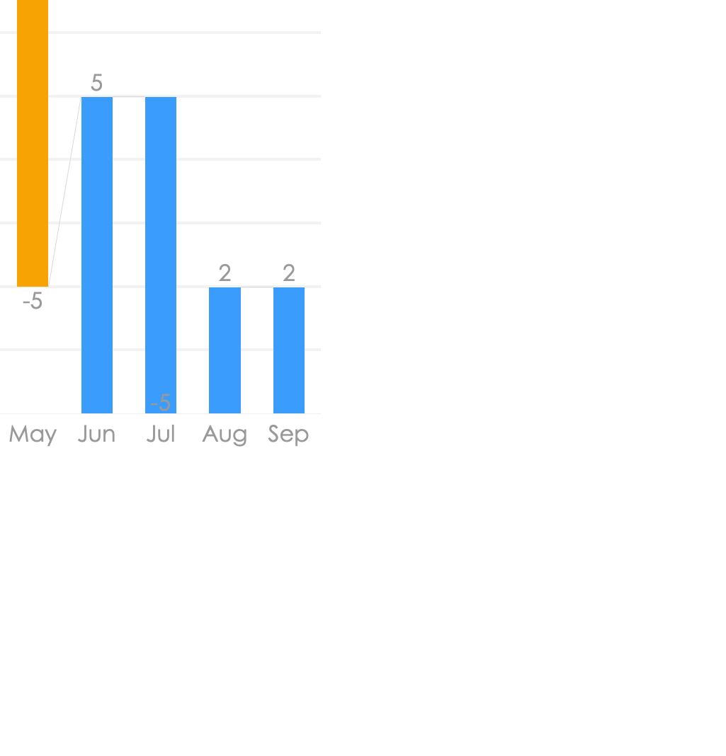
Waterfall Charts Infographics
Analysis of different brands and products.
35%
65%
Sells
Purchases
Business professionals like you connecting to share advice.
Business professionals like you connecting to share advice.

Slide 19
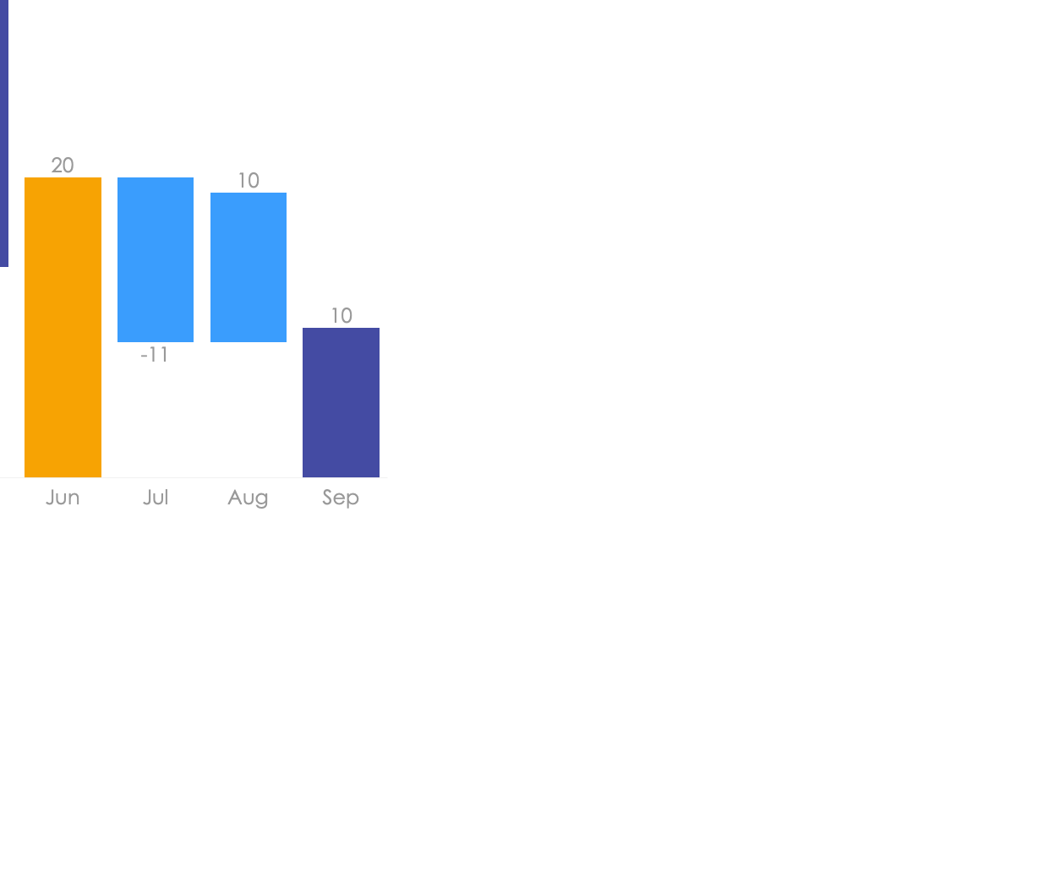
Waterfall Charts Infographics
Analysis of different brands and products.
Purchases
Sells
Returns
Business professionals like you connecting to share advice business professionals.

Slide 20
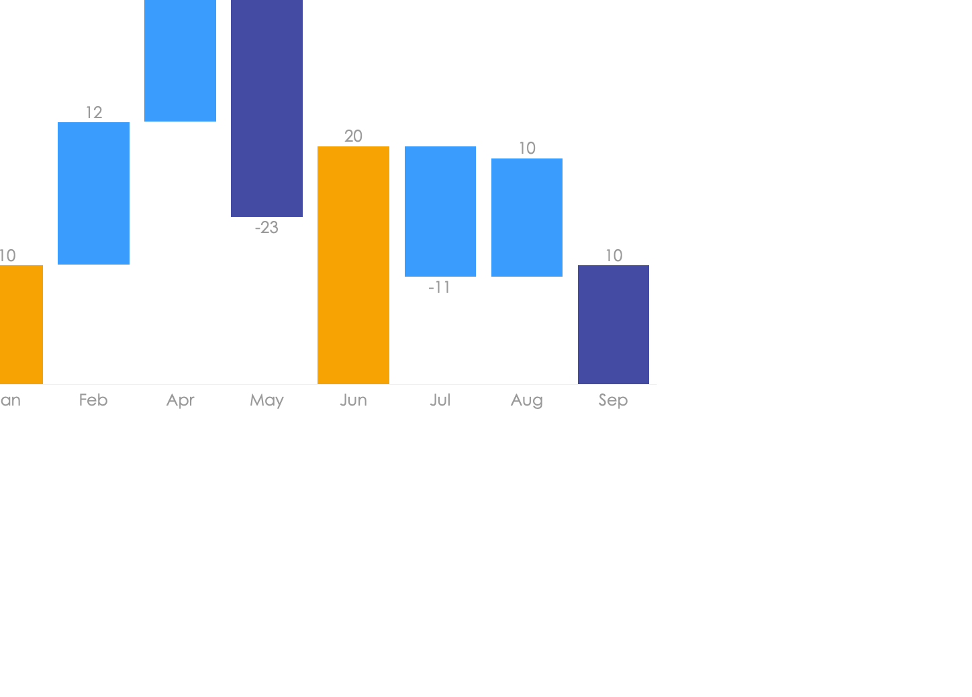
Waterfall Charts Infographics
Analysis of different brands and products.
Sell
40%
Business professionals like you connecting to share advice.
Buy
60%
Business professionals like you connecting to share advice.
Returns
80%
Business professionals like you connecting to share advice.

Slide 21
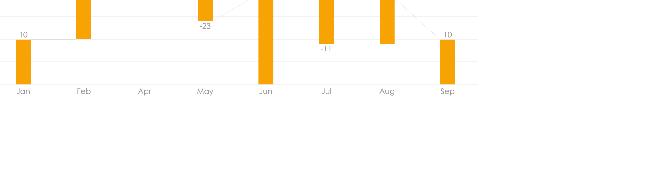
Waterfall Charts Infographics
Analysis of different brands and products.
That’s why we provide point solutions
Business professionals like you connecting to share advice. Business professionals like you connecting to share advice.

Slide 22
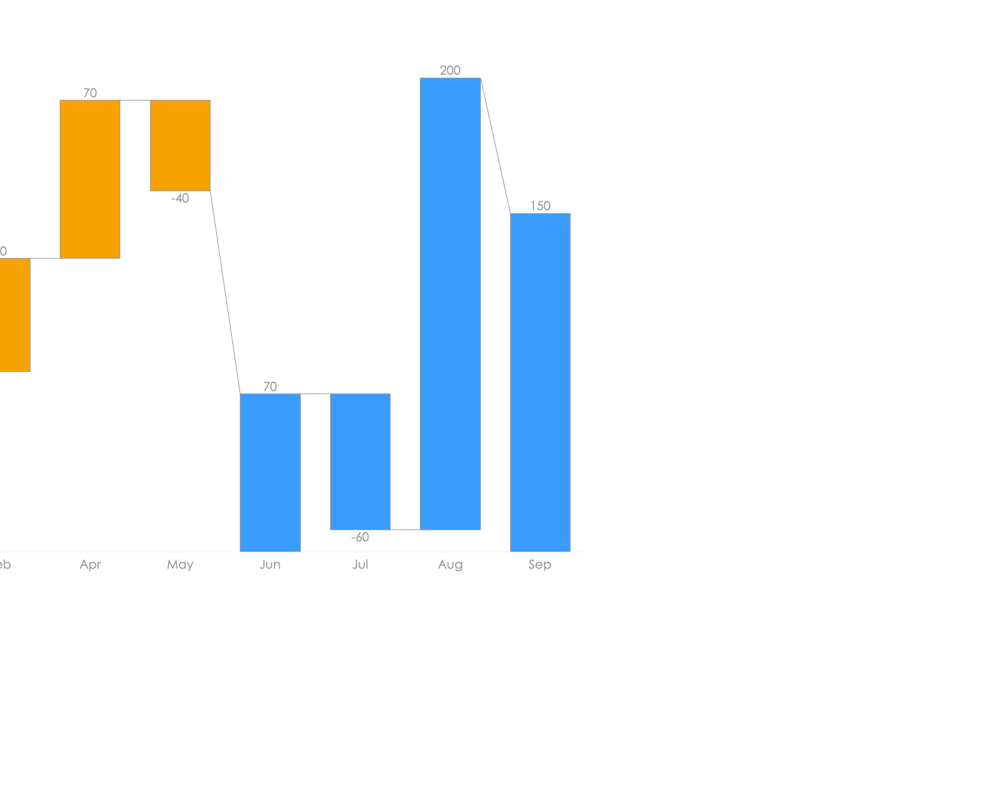
Waterfall
Charts
Infographics
Analysis of different brands and products.
Project 1
Business professionals like you connecting to share advice.
Project 2
Business professionals like you connecting to share advice.

Slide 23
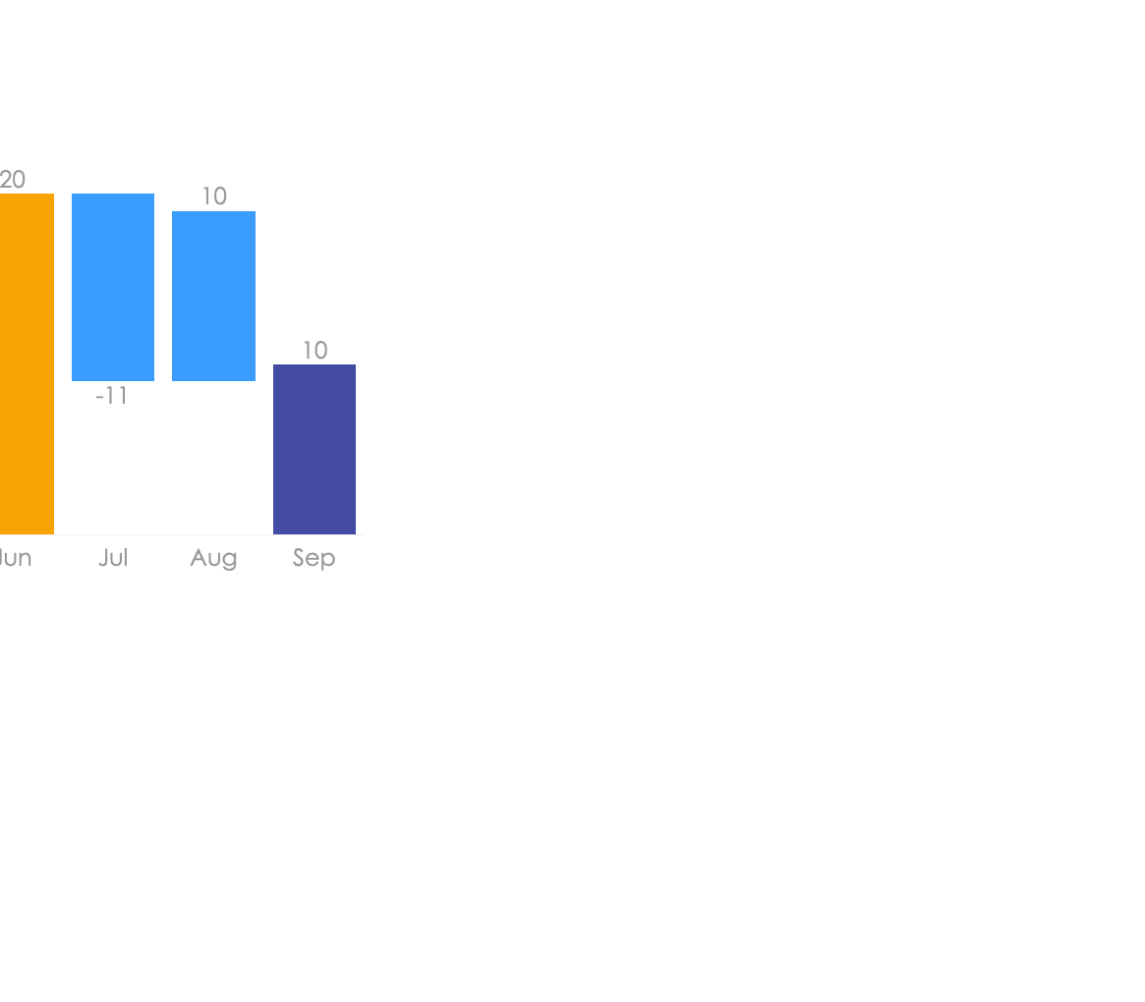
Waterfall Charts Infographics
Analysis of different brands and products.
Product | Task | Model | Status
Product 1 | WN12435 | V 1.2.5
Product 2 | WN81156 | V 2.2.5
Product 3 | WN62435 | V 7.2.5

Slide 24
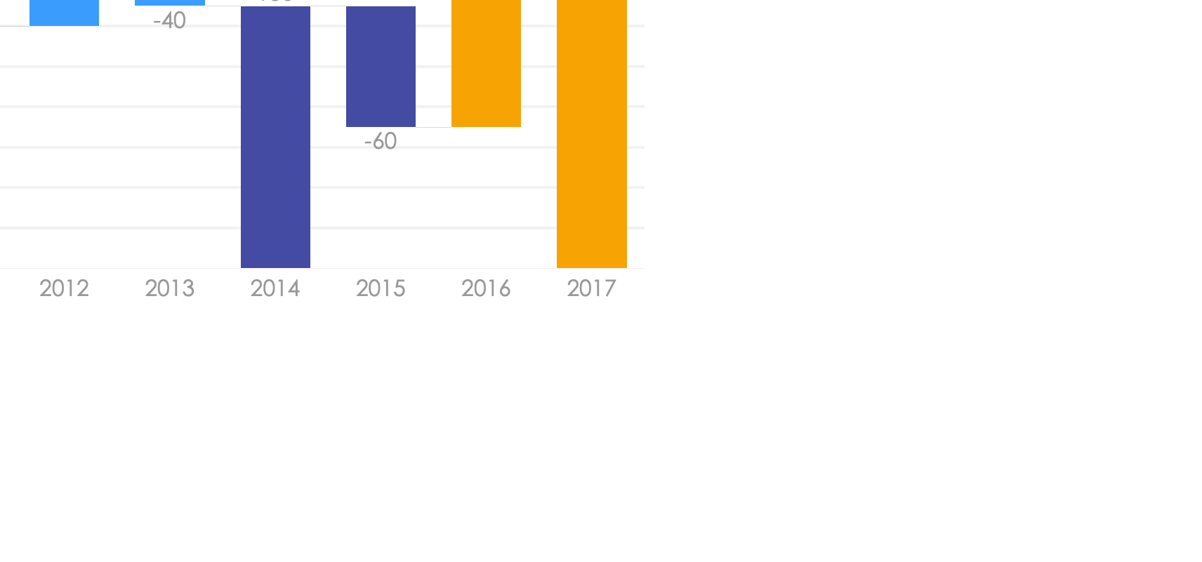
Waterfall Charts Infographics
Analysis of different brands and products.
Project 1
Business professionals like you connecting to share advice.
Project 2
Business professionals like you connecting to share advice.
Project 3
Business professionals like you connecting to share advice.
35%
Business professionals like you connecting to share advice. Business professionals like you connecting to share advice professionals like you connecting.

